Slide 1
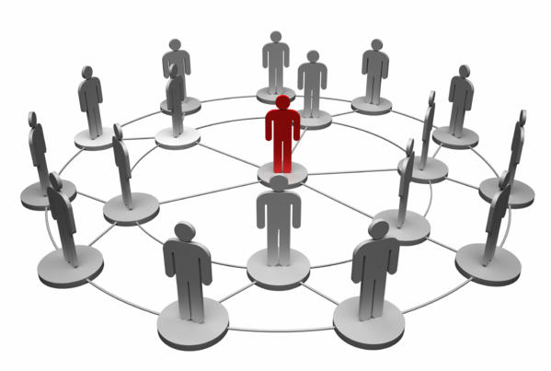
Impact of networks on Food Co. sales
How do we identify insightful patterns within our user base to create an optimized marketing strategy?
Shirish Dhar

Slide 2
Context
SITUATION
Food Co., a leading global specialty food retailer, wants to improve the efficiency of their promotional spend based on customers’ shopping behaviors in groups.
COMPLICATION
We have to conduct complex network analysis utilizing limited data to ensure that Food Co.’s fixed budget is used optimally.
QUESTION
How can we combine customers’ spending behavior and network behavior to identify impactful patterns and insights?

Slide 3
AGENDA
Process
Current Situation
Key Focus Areas
Analysis and Insights
Takeaways and Recommendations
Risks and Caveats

Slide 4
PROCESS
CURRENT

Slide 5
PROCESS
Approach
Technical Tools

Slide 6
Approach
Network Analysis
Worked with Python network package NetworkX to build network diagrams and find the most important nodes and biggest influencers.
Data Manipulation
Derived 17+ new features/columns from the existing set of features to gain a broader and deeper perspective into the data.
Performed clustering and correlation analysis on the data.
Visualizing Patterns
Identified patterns and insights and utilized visualization tools like Tableau and Matplotlib to display insights.

Slide 7
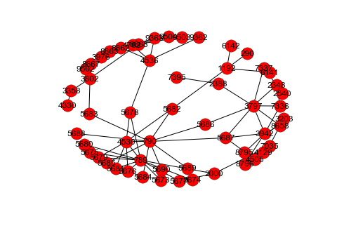
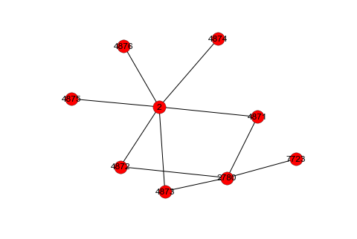
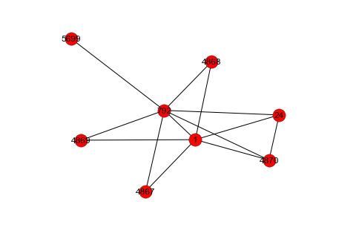
Network Analysis
Finding friend circles
Finding most ‘central’ nodes
Finding n-degree friends
Finding biggest subnetworks
Tools Used: NetworkX, Gephi

Slide 8
Data Manipulation
Initial Feature
Nodes
Revenue per year
Each friendship with strength
Zipcode
Derived Features through Data Manipulation
Number of Friends
Names of friends
Total shopping trips with friends
Average revenue of your friends
Average no. of friends of your friends
Total revenue ‘in your hands’
Spending Behavior Cluster (Low spending cluster/High spending cluster)
Similarity with friends by ‘revenue’
Similarity with friends by ‘number of friends’
Centrality in your network
Size of your network
Operations: Data Wrangling, Transformations, Normalizations, Clustering, Correlation
Tools Used: Python - Pandas, Numpy, Scipy, Scikit Learn

Slide 9
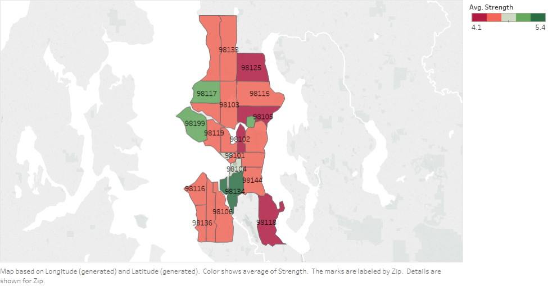
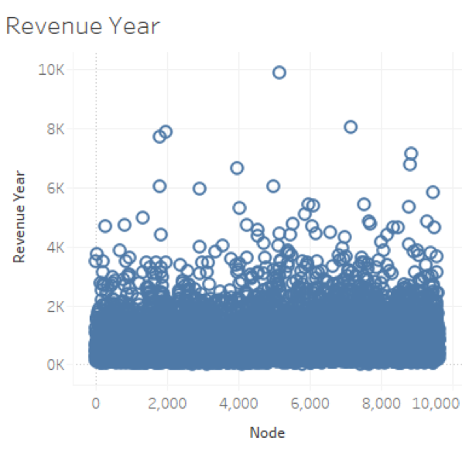
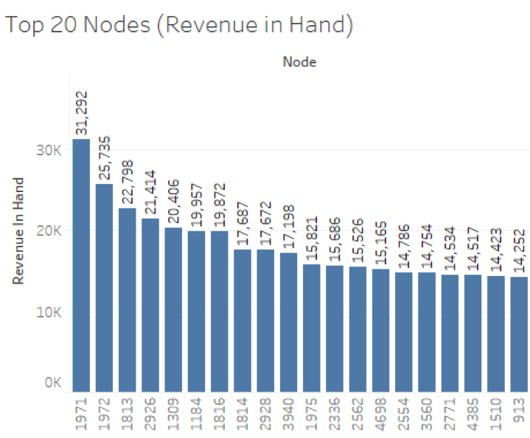
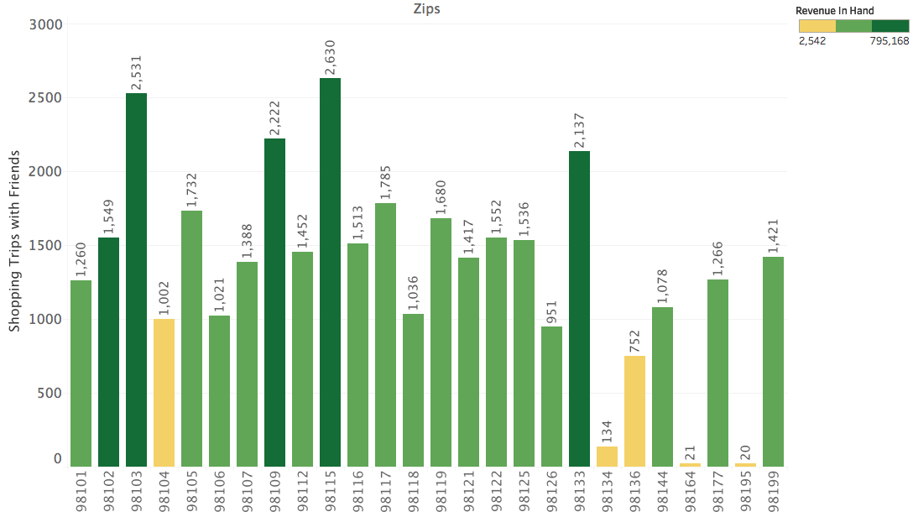
Data Visualization
Tools Used: Tableau, Matplotlib

Slide 10
Technical Tools
Network Analysis
NetworkX
Gephi
Data Manipulation
Pandas
Numpy
Scipy (Correlation)
Scikit Learn (Clustering)
Data Visualization
Tableau
Matplotlib

Slide 11
CURRENT SITUATION

Slide 12
Revenue Distribution
Total Nodes: 9268
Revenue spent per year towards Food Co. by each node

Slide 13
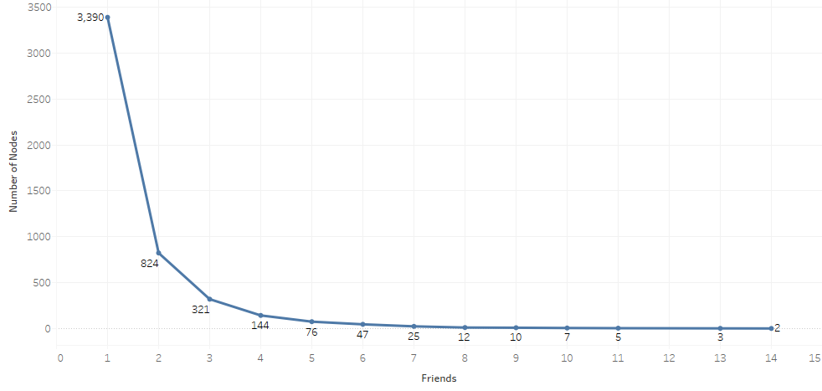
Friends Distribution
Distribution of number of nodes having a certain number of friends

Slide 14
KEY FOCUS AREAS

Slide 15
Key Focus Areas
1
Which customers should we spend our marketing dollars on?
2
How do friendships impact customer spend?
3
Do friendships/networks differ with Zip Codes?
4
Are relationships balanced?

Slide 16
Key Focus Areas
1. Which customers should we spend our marketing dollars on?

Slide 17
How do we define ‘importance’ of nodes?
Revenue Importance
Outreach Importance
Most Pivotal Nodes/Subnetworks

Slide 18
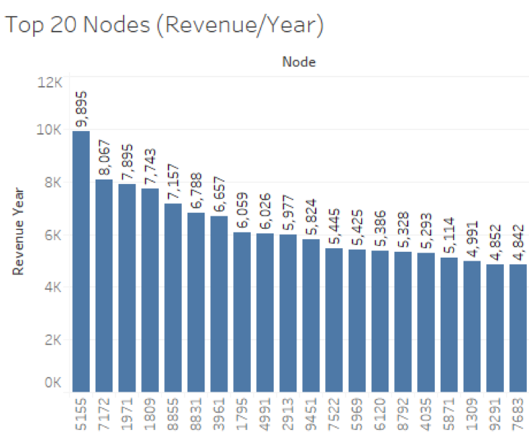
Revenue Importance
Layer 1 – Highest spenders per year

Slide 19
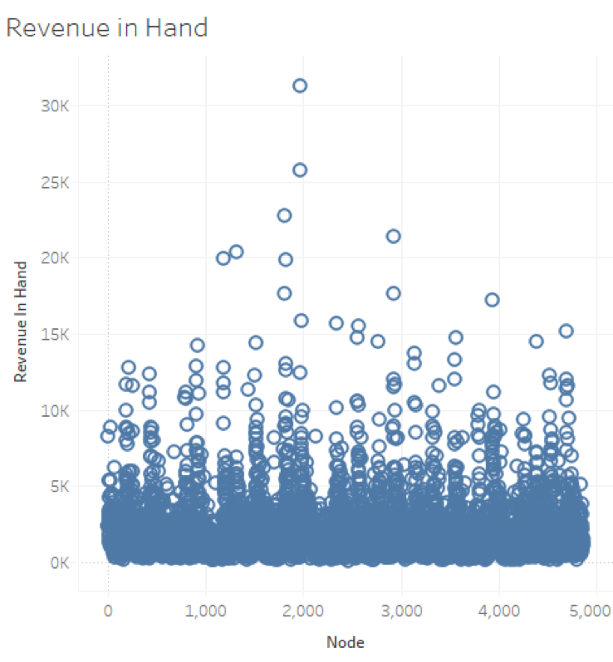
Revenue Importance
Layer 2 – Total Revenue ‘in your hands’
Notes:
Does it only matter how much your spend is? No. What matters even more is how much revenue is connected to you!!

Slide 20
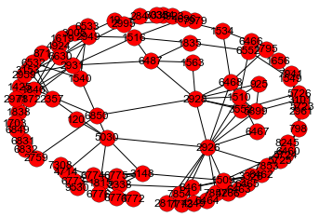
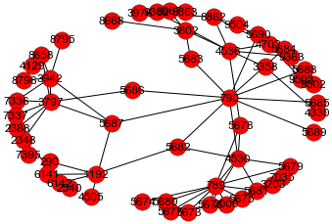
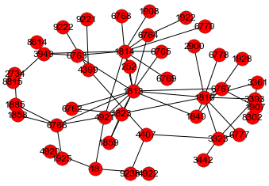
Outreach Importance
Biggest Networks
Size = 88 Nodes
Size = 56 Nodes
Size = 44 Nodes

Slide 21
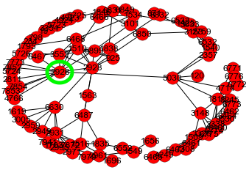
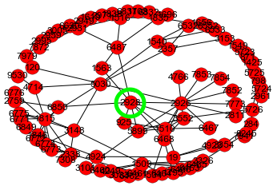
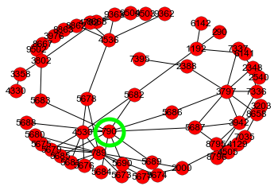
Outreach Importance
Most Central Nodes
2926
2928
709
Centrality – 4.5e-5
Centrality – 4.35e-5
Centrality – 2.07e-5
Utilizing ‘nx.betweenness_centrality’ measure in NetworkX

Slide 22
The Most Pivotal Nodes
Combining Outreach and Revenue Importance
2925
2927
1509
Network Size = 88
Revenue in Hand = $21413/yr
Network Size = 88
Revenue in Hand = $17671/yr
Network Size = 88
Revenue in Hand = $14423/yr

Slide 23
Key Focus Areas
2. How do friendships impact customer spend?

Slide 24
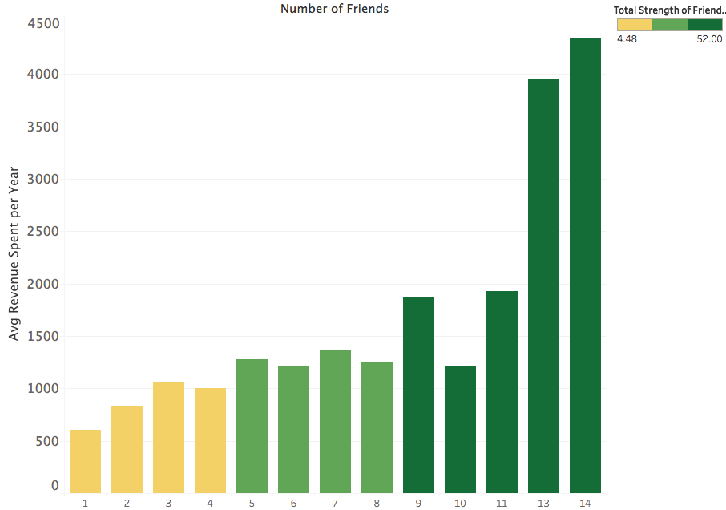
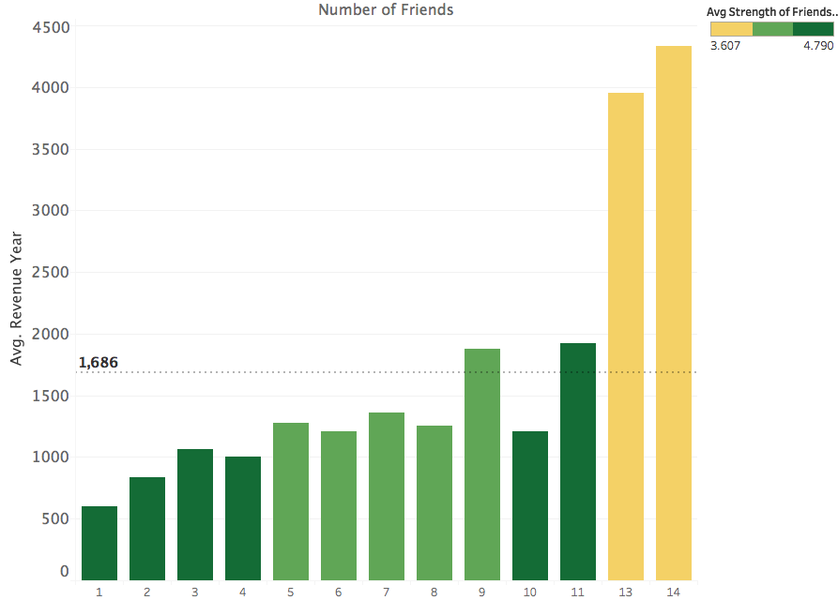
Impact of connections on yearly spend
With Total strength of friendships (Num of shopping trips with your friends)
With average strength of friendships (Avg num of shopping trips with each friend)

Slide 25
Key Focus Areas
3. Do friendships/networks differ with Zip Codes?

Slide 26
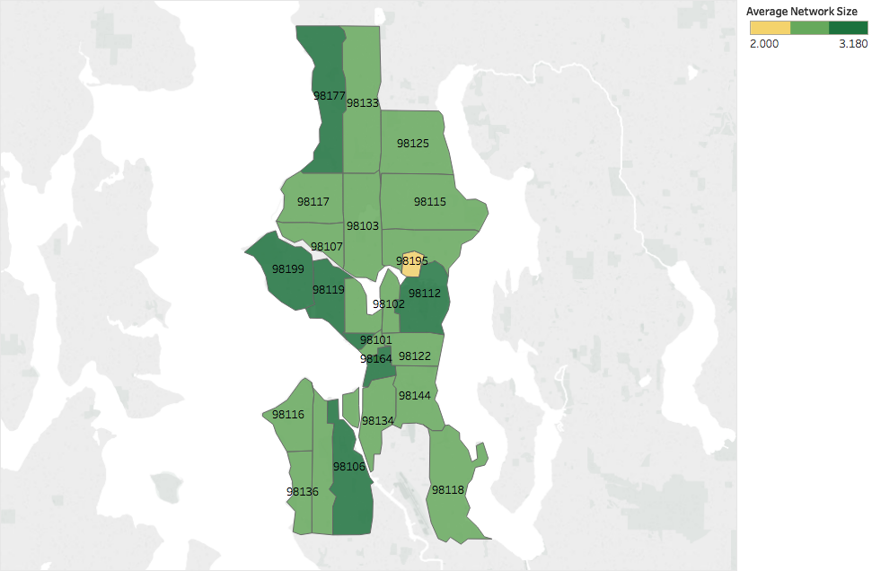
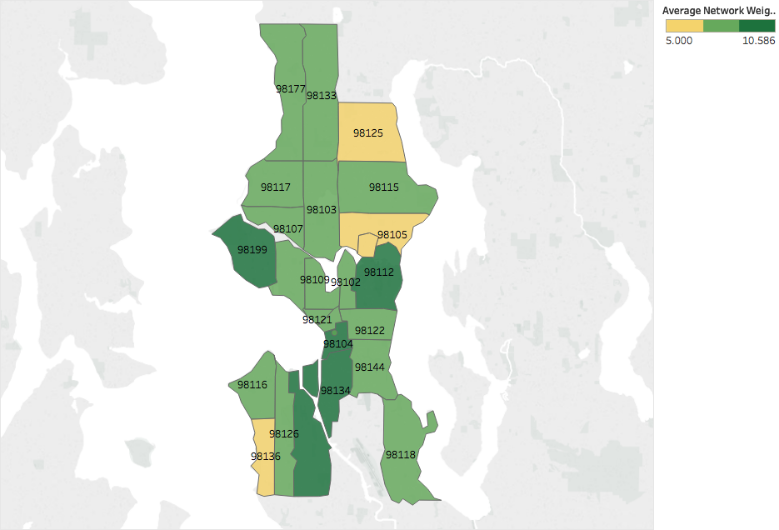
Structure of networks based on zip codes
Average Network Sizes
Average Network Weights
Summary – Zips 98199, 98112 and 98106 have larger networks and more shopping trips with friends

Slide 27
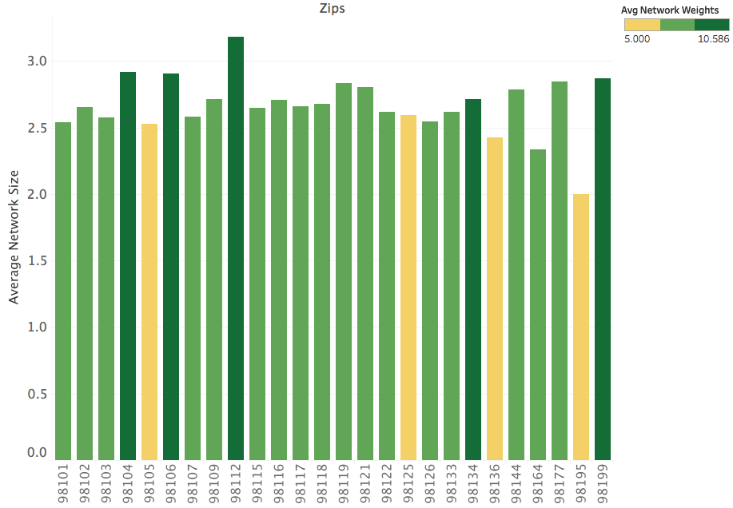
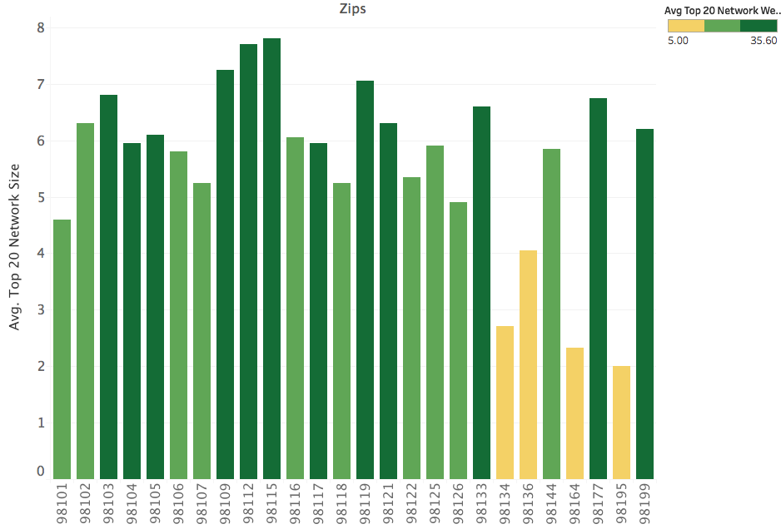
Structure of top 20 networks within each zip code
Top 20 networks
Average Network Size of all networks in each zip
Average Network Size of the top 20 networks in each zip

Slide 28
Other patterns with zip codes

Slide 29
Key Focus Areas
4. Are relationships balanced?

Slide 30
Step 1 - Clustering
Silhouette Score Method
(Choose optimal number of clusters)
Employ k-means clustering to create distinct clusters

Slide 31
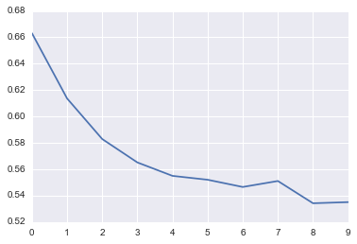
Silhouette Score
Silhouette Score
2
3
4
5
6
7
8
9
10
11
Number of Clusters

Slide 32
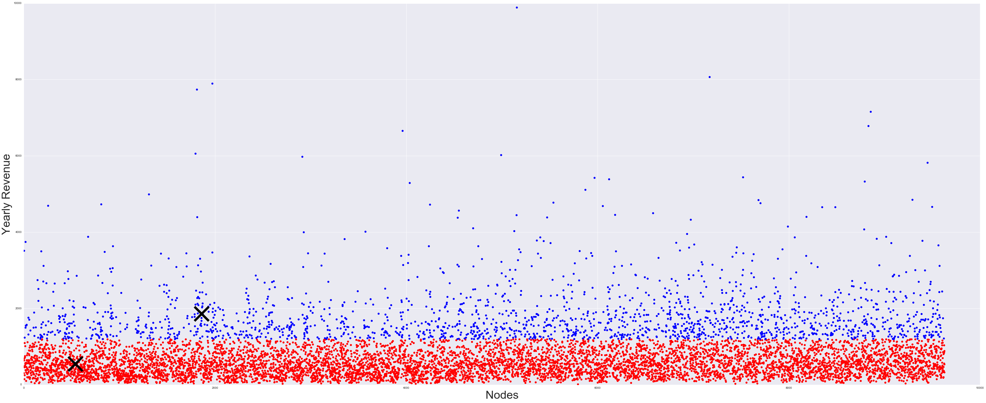
Two Clusters
10000
Cluster 1 – High Spenders
Cluster 0 – Low Spenders
8000
6000
4000
2000
2000
4000
6000
8000

Slide 33
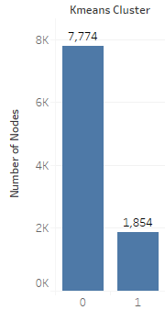
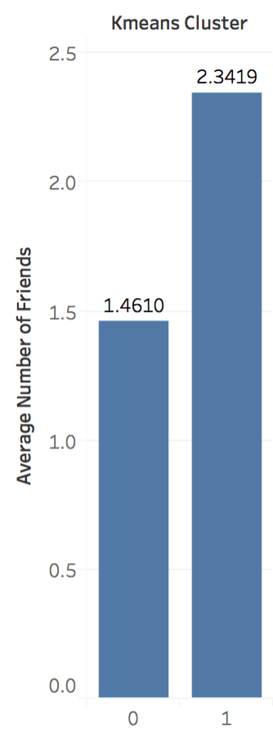
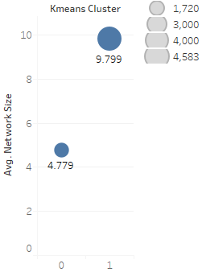
Patterns in Clusters
0 - Low Spenders | 1 – High Spenders
Total Revenue in Hand

Slide 34
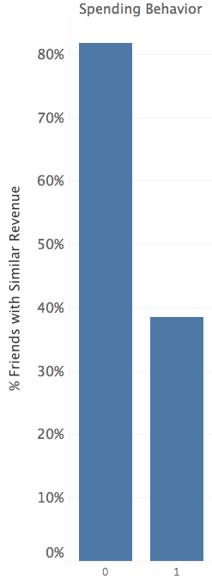
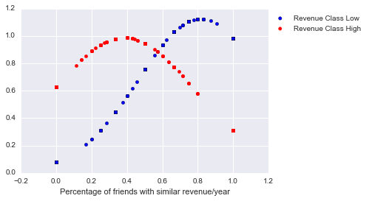
Do customers have friends with similar revenues?
Analysis – What % of your friends fall in your own cluster?
Spearman’s Correlation between your ‘Revenue spend/yr’ and your friends’ ‘Revenue spend/yr’ = 0.36

Slide 35
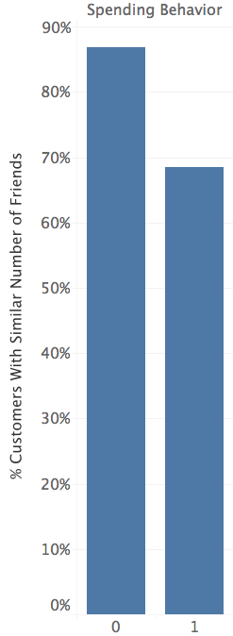
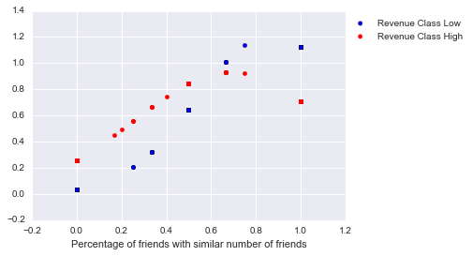
Do customers and their connections have similar number of friends?
Analysis – What % of your friends have similar number of friends?
% customers having friends who have similar number of friends
Spearman’s Correlation between your ‘Number of Friends’ and your friends’ ‘Number of Friends’ = 0.43

Slide 36
KEY TAKEAWAYS

Slide 37
Key Takeaways
Customer Level
Most people’s shopping networks are limited to pairs
Nodes 1971, 1972, 1813 and 2926 have the highest ‘revenue in hand’
The biggest network that shops at Food Co. contains 88 nodes
Nodes 2926, 2929 and 709 are the most central nodes
Nodes 2925, 2927 and 1509 have the best combination of revenue and number of connections
On an average, lower spenders shop with similar friends more than higher spenders do
Zip Code Level
Nodes in zips 98115, 98103, 98133 and 98109 spend the most in Food Co. per year
Zips 98115, 98103, 98133 and 98109 also have the highest number of shopping trips amongst friends
Zips 98112, 98199, 98104 and 98106 have the biggest and strongest networks

Slide 38
RECOMMENDATIONS

Slide 39
Recommendations
How do we make the big spenders stick?
How do we increase spend of low spenders?
Targeted Marketing
Loyalty Programs
Referral Bonuses
Membership Offerings
Do not forget the majority
Focus more on the most important low spenders and influencers
Offer more discounts
Increase marketing in the most profitable zip codes

Slide 40
RISKS AND CAVEATS

Slide 41
Risks and Caveats
We know the number of shopping trips a customer makes with their friends, but we do not know the number of shopping trips they make alone.
The dataset offers spend data, not income data. Having income data would add a valuable dimension to the dataset.
Lack of demographic data – Age, Gender, Race. This would have helped in clustering.
No knowledge of trends over time.
No knowledge of the market and competitions of Food Co.
No knowledge of product mix and store mix.
No knowledge of spending habits of customers.

Slide 42
Appendix

Slide 43
Looking Ahead
Acquire more detailed and descriptive customer data to make more informed decisions
Create more Food Co. stores in the most profitable zip codes
Optimize next generation of Food Co. store locations to be distance optimized closer to the most profitable networks
Test out the success of loyalty programs and marketing programs towards different groups of customers

Slide 44
Issues Faced in Analysis
Friendship data was given for only part of the dataset. Assumption made – This part of the dataset represents nodes Food Co. cares about because they are Seattle nodes.
There was a dilemma regarding the amount of focus to be put on all connections vs first degree connections.
The amount of features on offer were few, and scaling them to derive 17+ features was a challenge.
Subjectively binning customers based on revenue was full of biases and offered low insight.
Deriving complex features like ‘Revenue Similarity with Friends’ and ‘Friend Count Similarity with Friends’ from basic features was challenging.

Slide 45
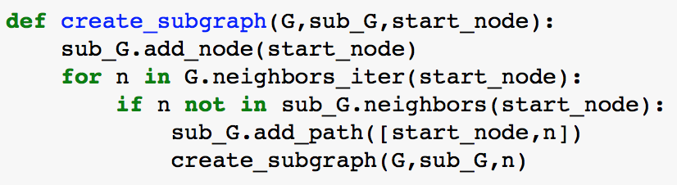
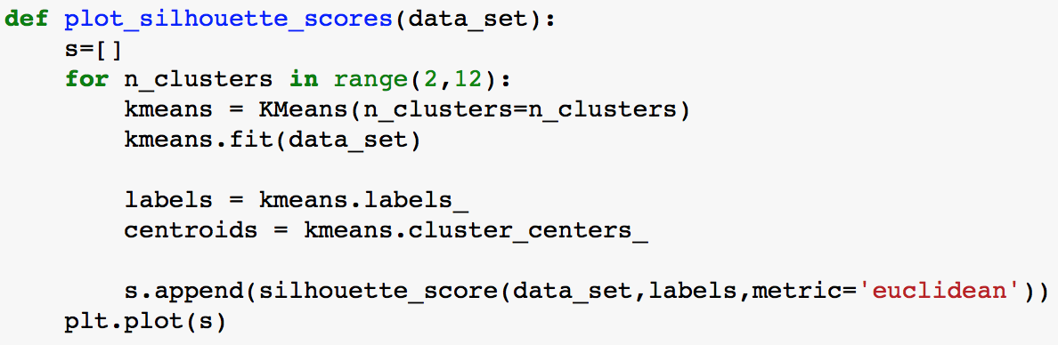
Important Code Snippets and Commands
Networkx.node_connected_component(G, 1) – Gives all degree connectiones of node 1
nx.betweenness_centrality – Provides the centrality of nodes in a network
- Visualizing subgraphs by providing node names
- Calculates silhoutte scores for a range of cluster numbers

Slide 46
Thank you

